Slide 1

Causality-Free Modeling of a Wind Turbine with Open-loop and Closed-loop Validation
Results
Kazi Mohsin, Mohammad Odeh, Tri Ngo, Tuhin Das
Department of Mechanical & Aerospace Engineering
University of Central Florida

Slide 2

Presentation Outline
Modeling approach
Model overview
Validation & discussion
Conclusion & future work

Slide 3
Modeling Approach
Control-oriented, Reconfigurable, and Acausal Floating Turbine Simulator (CRAFTS)
CRAFTS is built using an object-oriented, declarative, multi-domain modeling language Modelica
Acausal connection of components governed by mathematical equations
Features:
  Plug and play
  Reuse/swapping of model
  Increased composability
  User-friendly and computationally efficient to facilitate control co-design

Slide 4
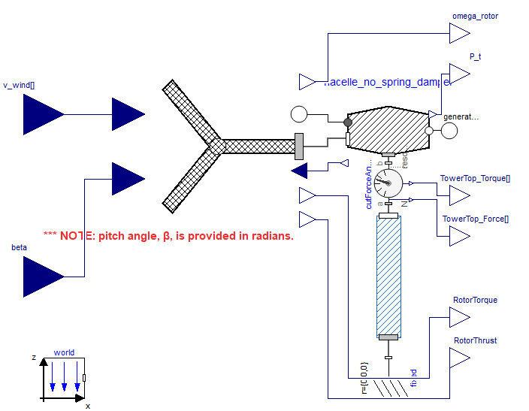
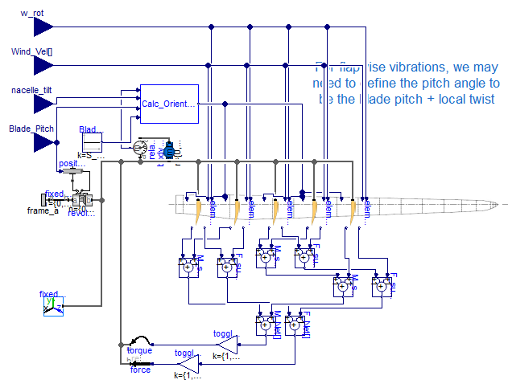
Modeling Overview

Slide 5
Modeling Overview
 | Open Fast | CRAFTS
Wake/Induction Model | Dynamic BEM | BEM
Blade/Airfoil Model | Unsteady Polar | Static Polar
Dimension | 3D | 3D
Domain | System | System
Linear/Non-Linear Model | Non-linear | Non-linear

Slide 6
Test Cases
TC 1.x: Rotor speed maneuvers
TC 2.x: Pitch maneuvers
TC 3.x: Turbine control for a variety of wind conditions

Slide 7
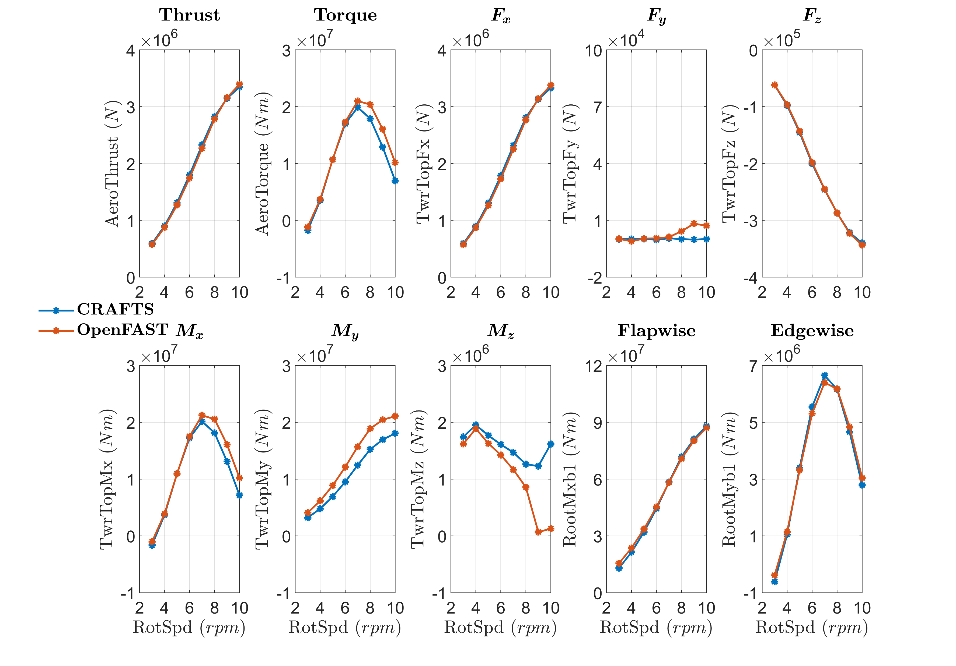

Validation: TC 1.1
TC 1.1
$V_{∞}=12.83 m/s$ , $β=0°$
Slight discrepancy at higher rpm for rotor torque.
Torque value of $2×{10}^{7} N.m$ @ $7.56 rpm$

Slide 8
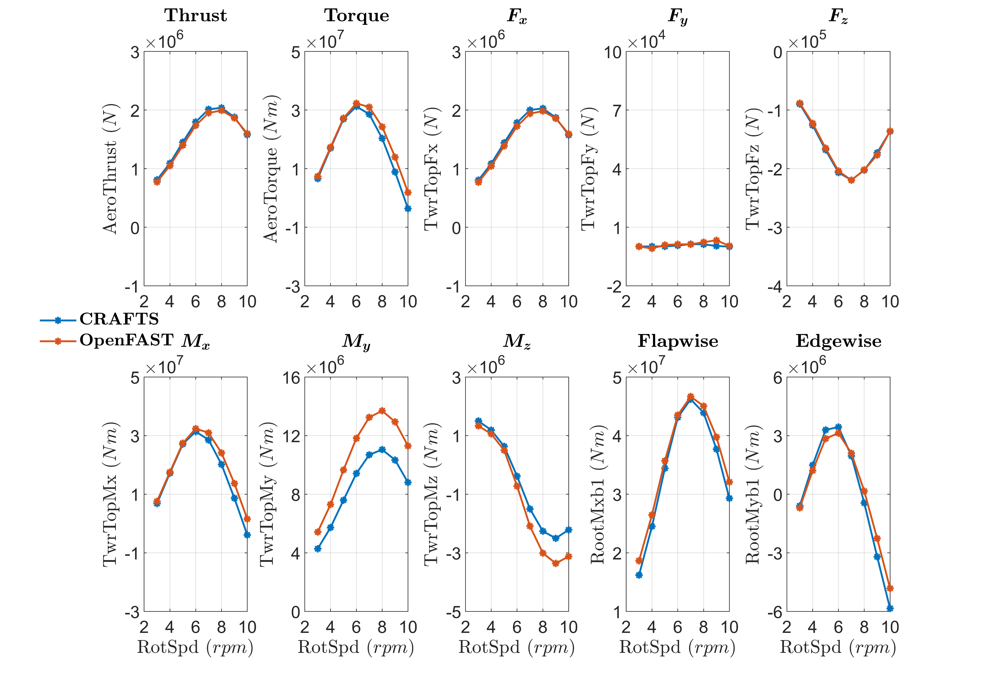

Validation: TC 1.2
TC 1.2
$V_{∞}=18.39 m/s$ , $β=9°$
Thrust value of $2.8×{10}^{6} N$ @ $7.56 rpm$

Slide 9
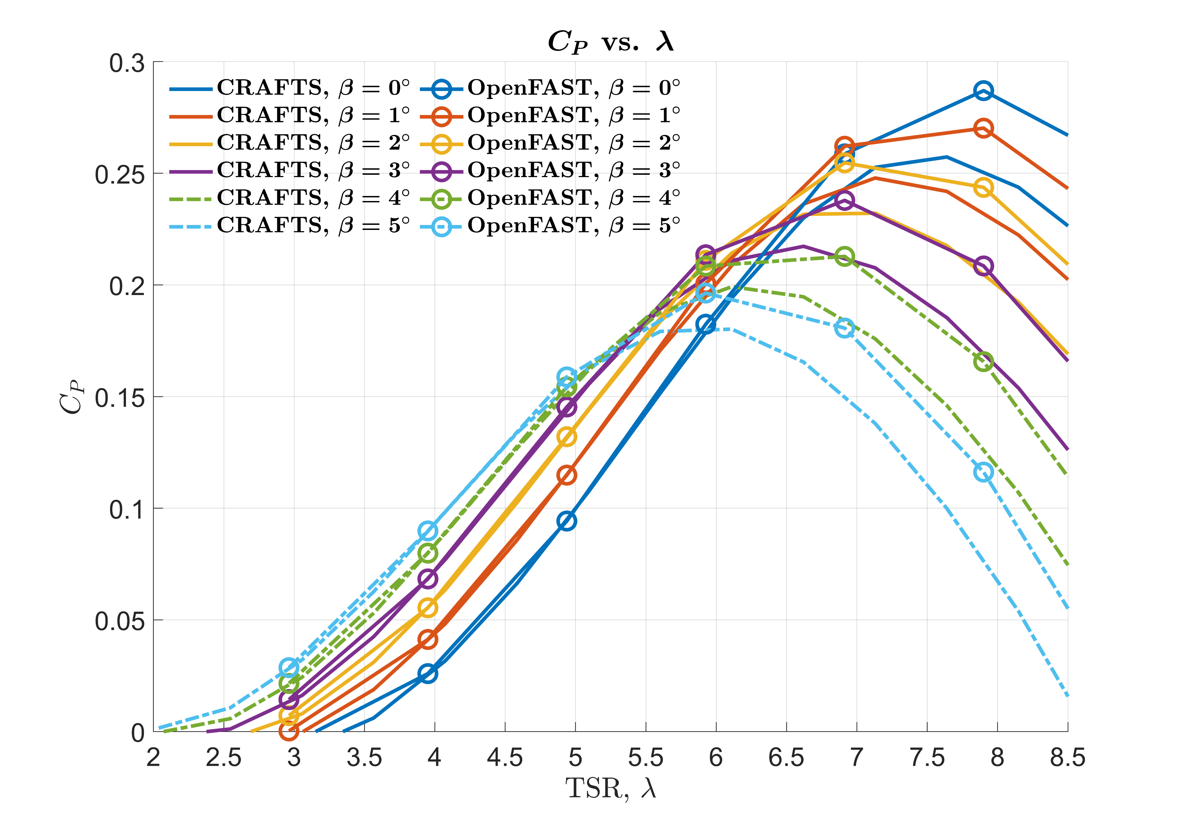
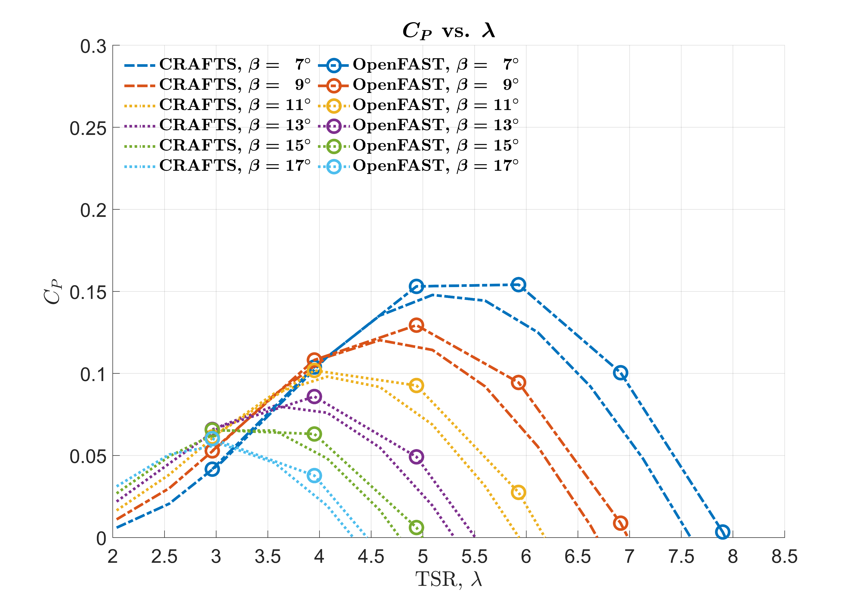
Validation: $C_{P}−λ$ curves

Slide 10
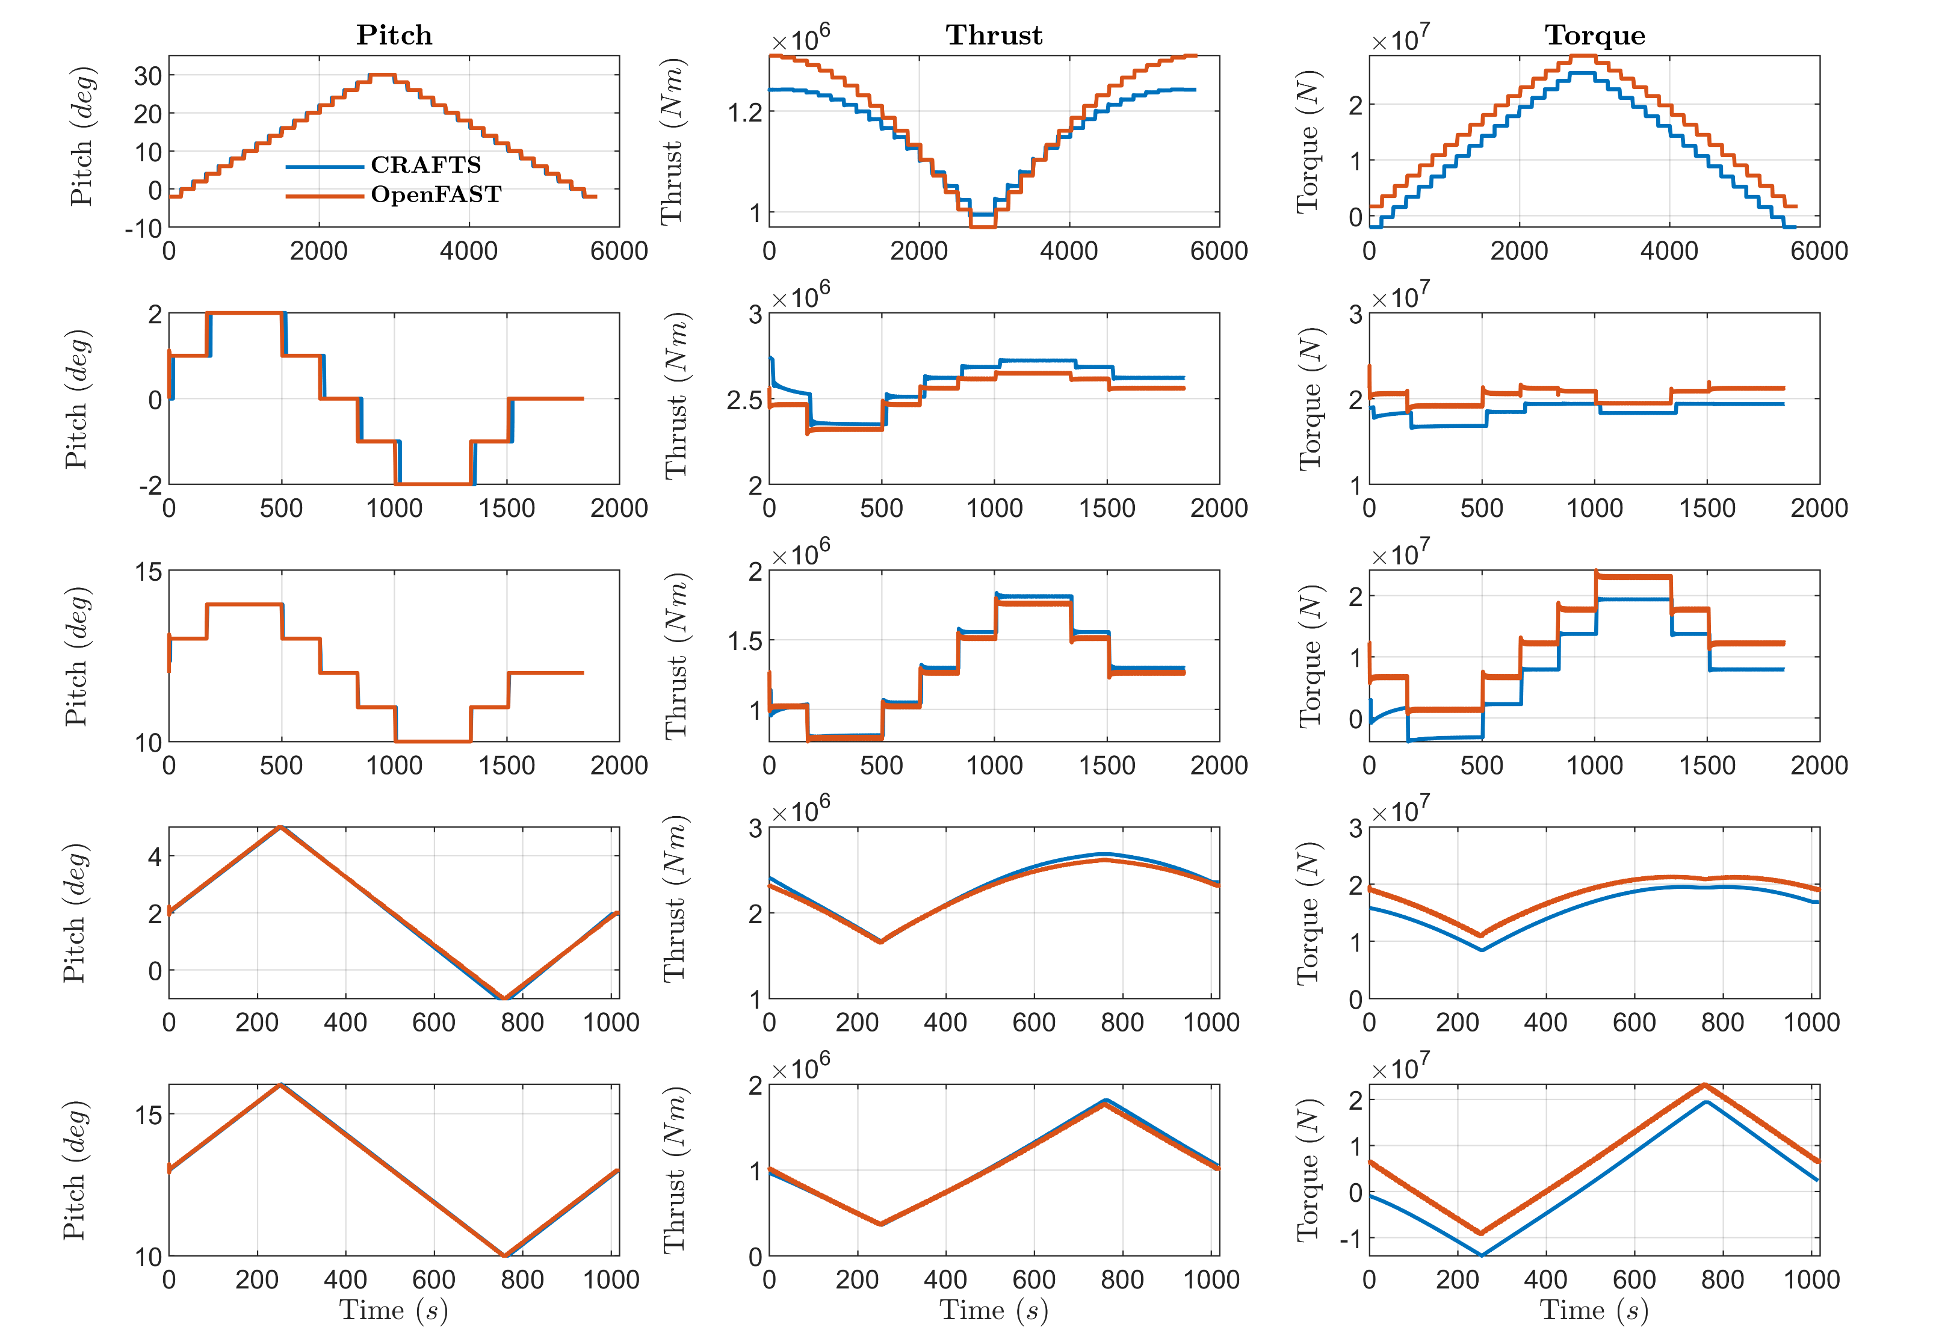
Validation: TC 2.x
Pitching Maneuvers
Step inputs: 3
Ramp inputs: 2
No hysteresis effect

Slide 11
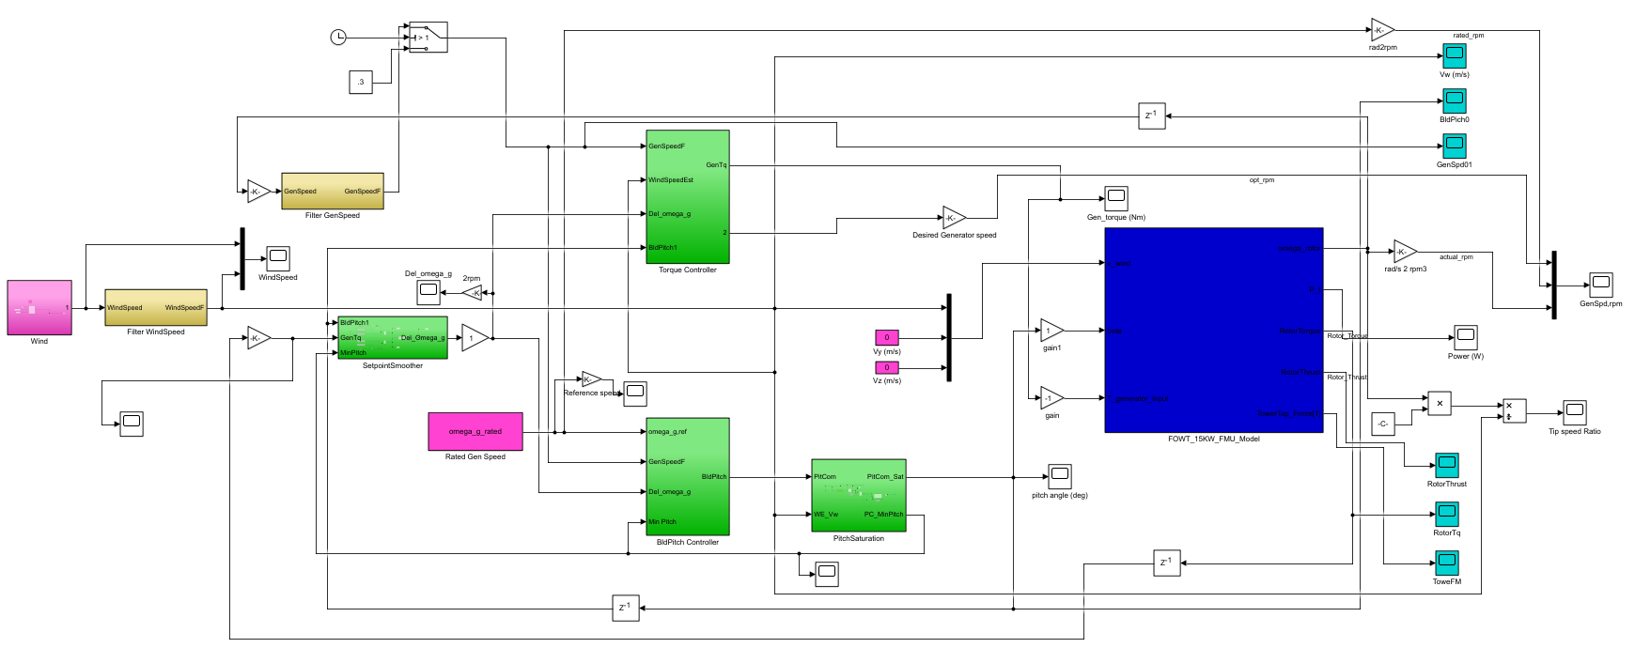

Validation: TC 3.x
Test cases:
TC 3.1: Stepped wind $8−30−8$
TC 3.2: Wind gust
TC 3.3: Sinusoidal Wind
Controllers:
ROSCO controller

Slide 12
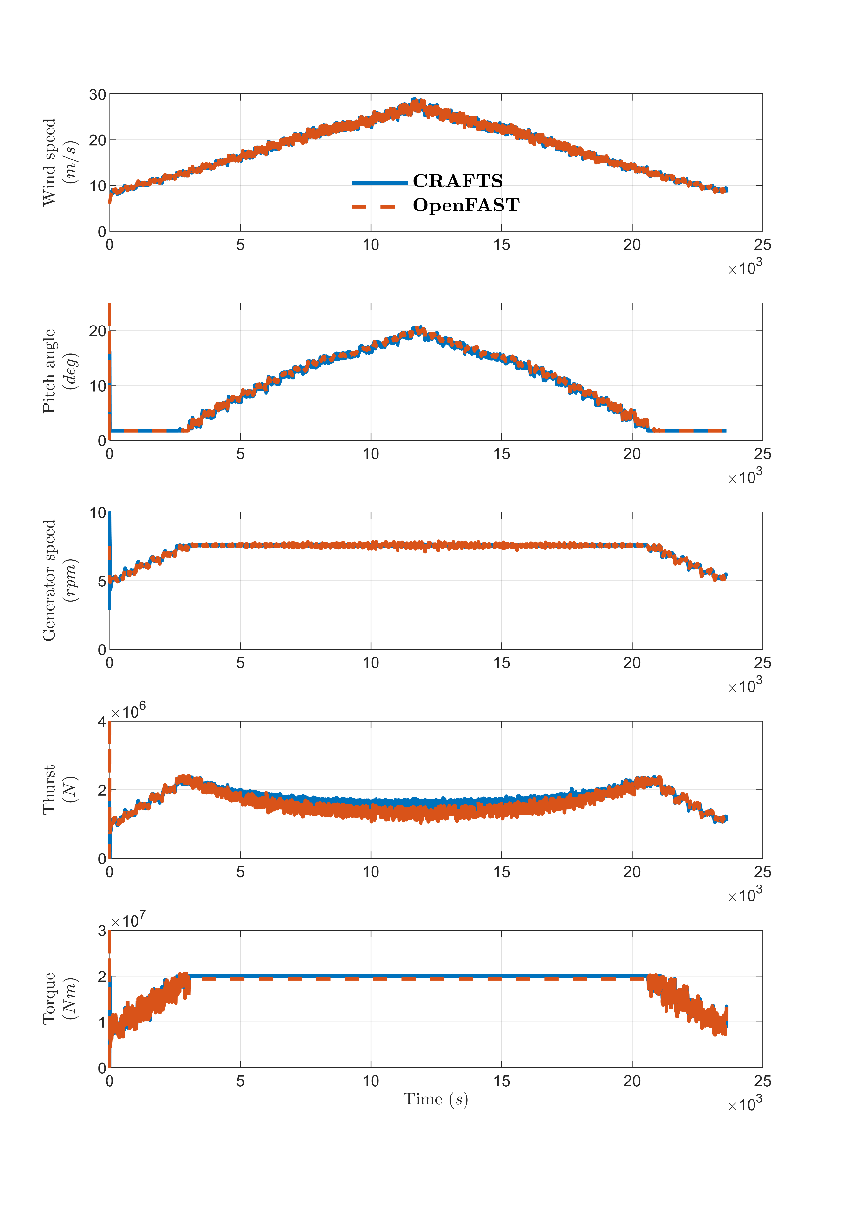
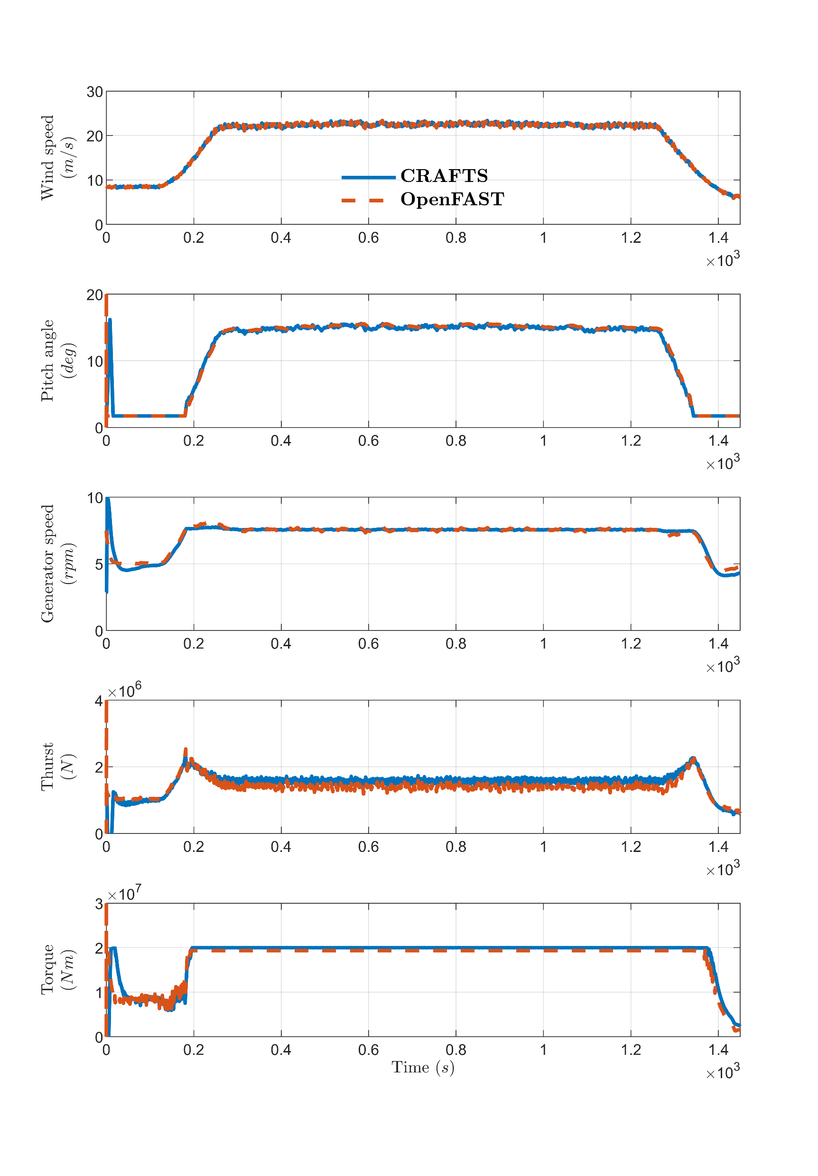
Validation: TC 3.1–2
Plant: CRAFTS v/s OpenFAST
Controller: ROSCO

Slide 13
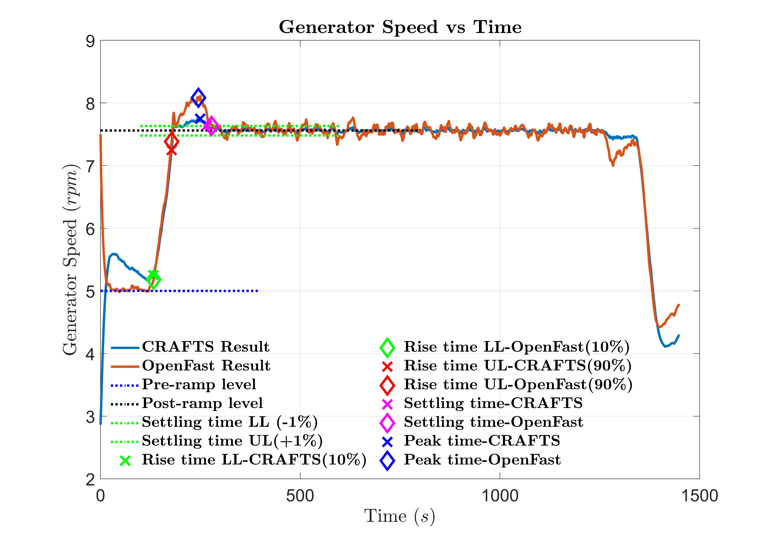
Validation: TC 3.2
Plant: CRAFTS v/s OpenFast
Controllers: ROSCO
Time Domain Analysis
Similar rise, peak, settling time
Higher overshoot in OpenFAST

Slide 14
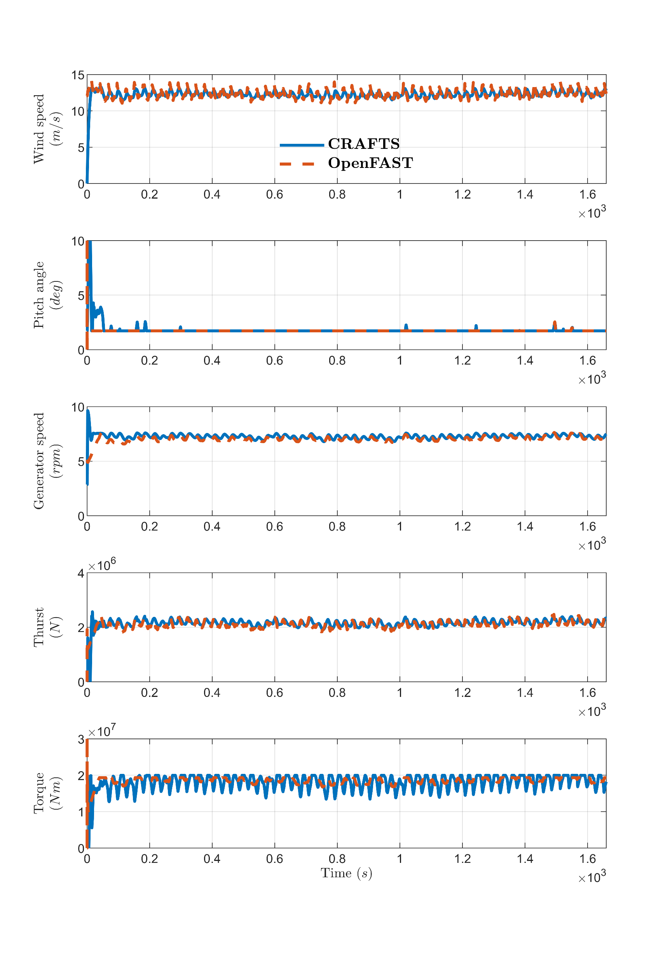

Validation: TC 3.3
Plant: CRAFTS v/s OpenFAST
Controller: ROSCO
Sinusoid @ $f=0.036 Hz$

Slide 15
Conclusions & Future Work
Control-oriented, Reconfigurable, and Acausal Floating Turbine Simulator (CRAFTS).
Validated against OpenFAST, an industry-standard platform, for several test cases.
Floating platform will be incorporated to model FOWTs.
Co-control design with individual pitch control, mooring line actuation, and multivariable robust control will be explored.

