Slide 1


Load Reduction of Wind Turbines Using Integrated Torque, Collective Pitch, and
Individual Pitch Control Actions
Authored by:
Mohsin, Kazi
Odeh, Mohammad*
Ngo, Tri
Das, Tuhin

Slide 2

Motivation
Demand
  Increasing energy requirements
  Growing interest in sustainable resources
Increase adoption of renewables
  Reduce the Levelized Cost of Energy (LCOE)
    Simple approach to measure the lifetime costs divided by energy production
  Improve life span of components by reducing fatigue loads (reduce cost over lifetime of plant)
  Improve performance of plant (increase electrical energy production of lifetime of plant)

Slide 3
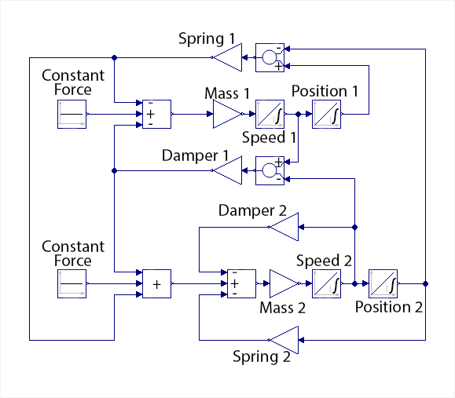
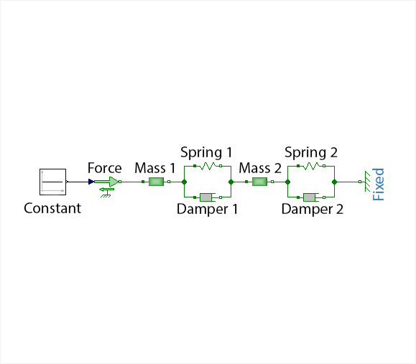
Model Properties
Control-oriented, Reconfigurable, Acausal, Floating offshore Turbine Simulator (CRAFTS)
Causality free
  I/O relations between components not explicitly stated (reduces development complexity)
  Flexible and adaptable
  Avoids making strong assumptions
  No specific causal direction provides new insights about unexpected system interactions
  Efficient “engineering friendly” modeling approach vs. equation-of-motions based modeling
    Model is constructed component-by-component without the need to worry about adapting the EOM

Slide 4
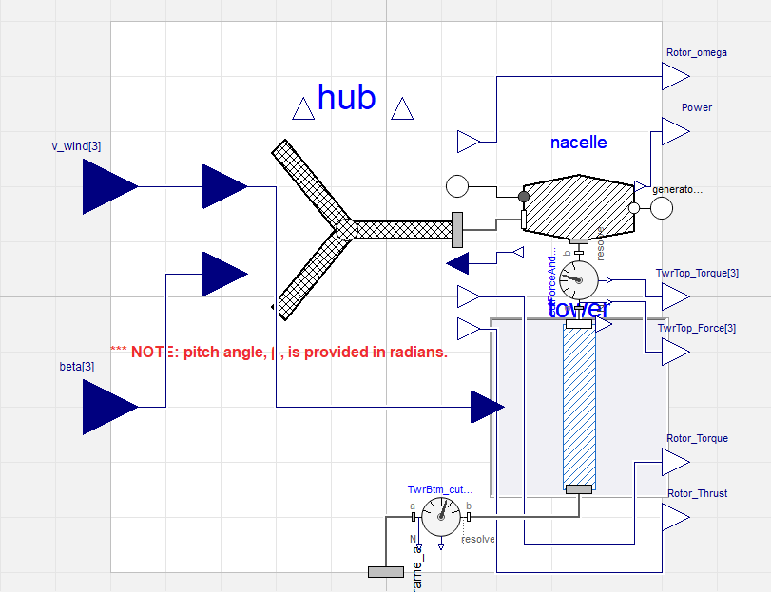
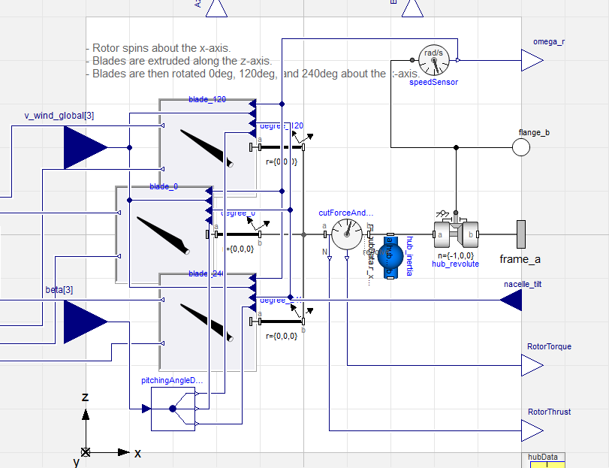
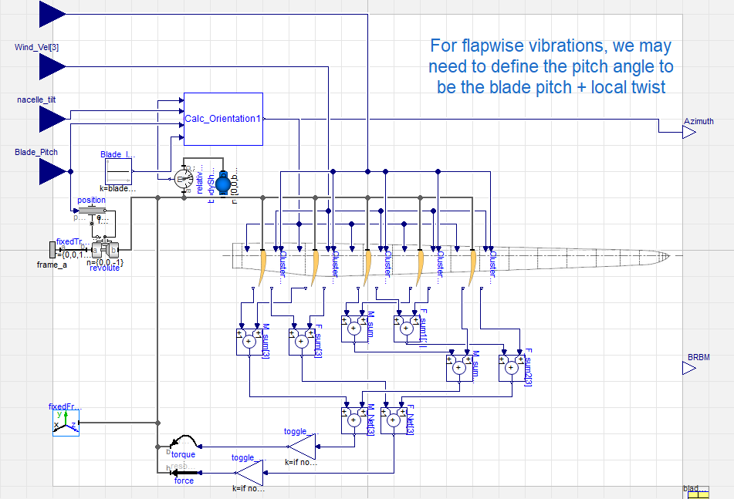
Model Properties
Hierarchy based
  Facilitates design changes
  Robust modelling with naturally clustered data
  Generalizability
  Hierarchy is natural, allowing for a physical modeling approach instead of mathematical
  Component level testing allows for faster prototyping and debugging
Turbine
Hub
Blade

Slide 5
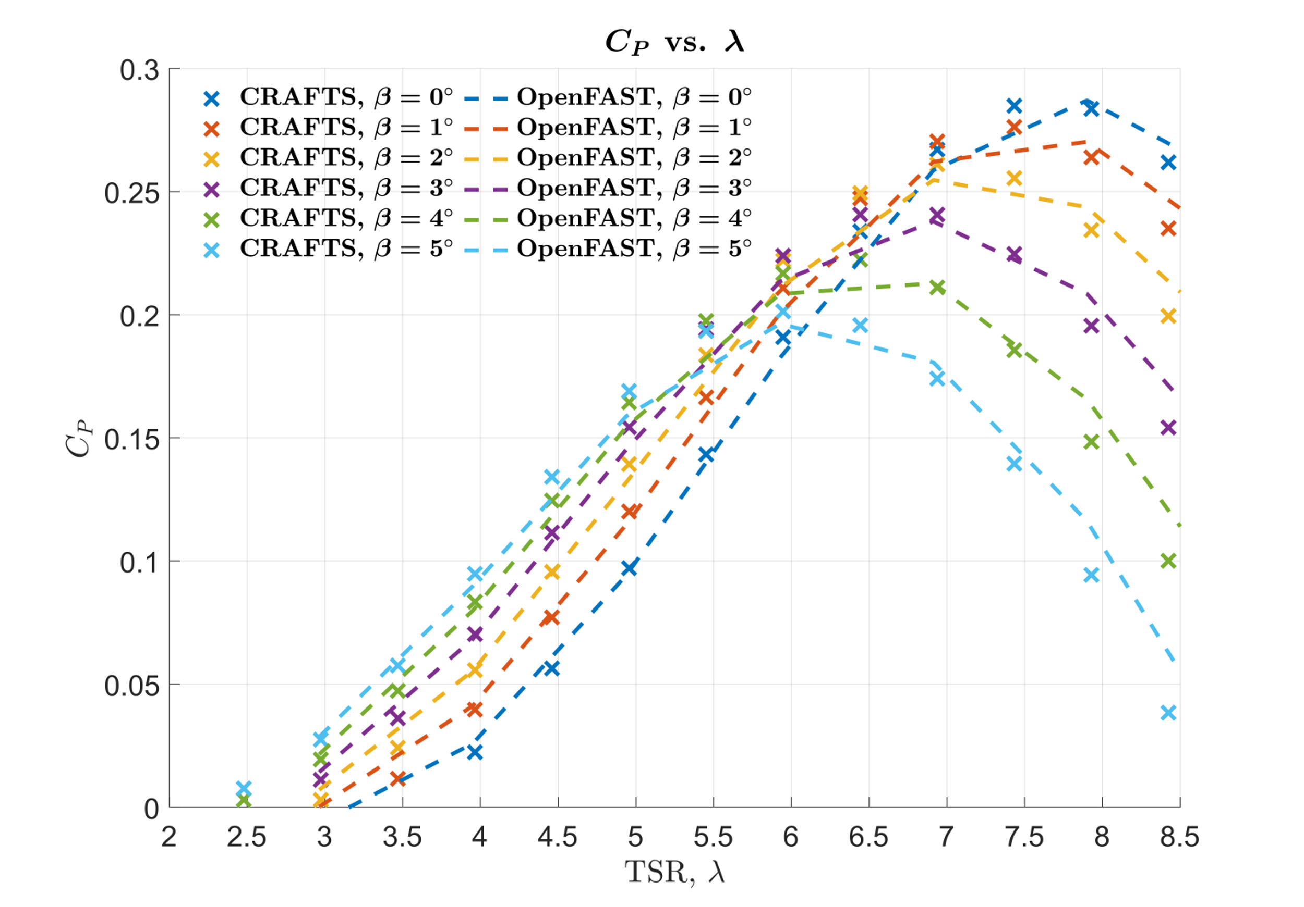
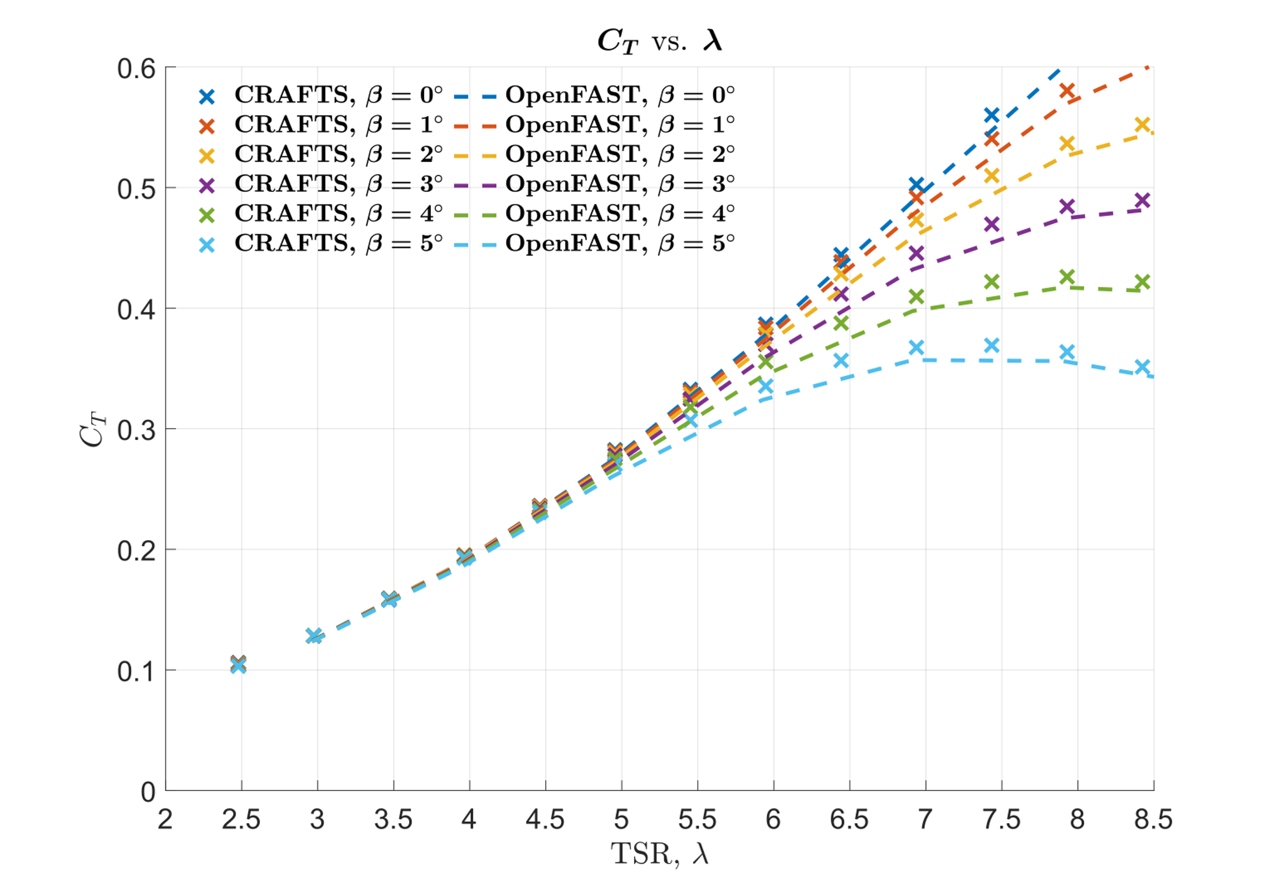


Model Properties
Validated against OpenFAST and FOCAL experimental data
  Made possible by the ARPA-e ATLANTIS program, which funded multiple partners and collaborators
  CRAFTS vs. OpenFAST: $C_{P}−λ$curve
  CRAFTS vs. OpenFAST: $C_{T}−λ$curve

Slide 6


Slide 7
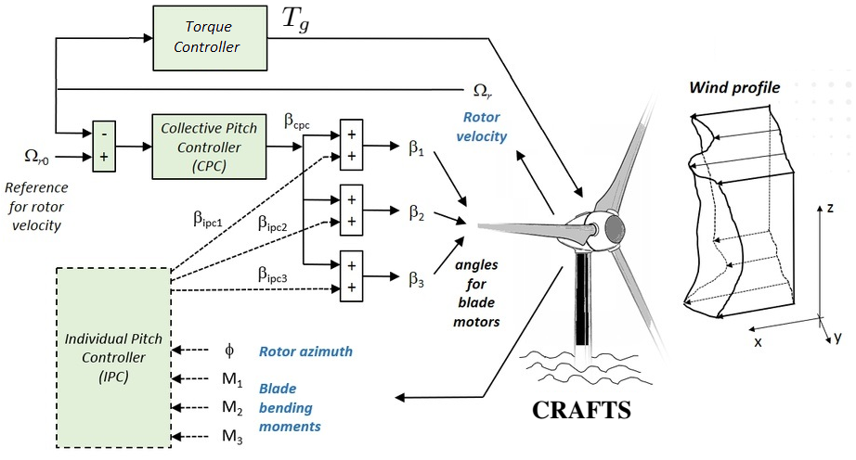
Control Module: Overview

Slide 8
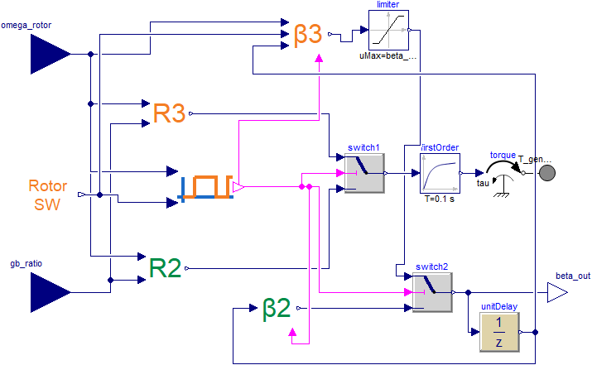
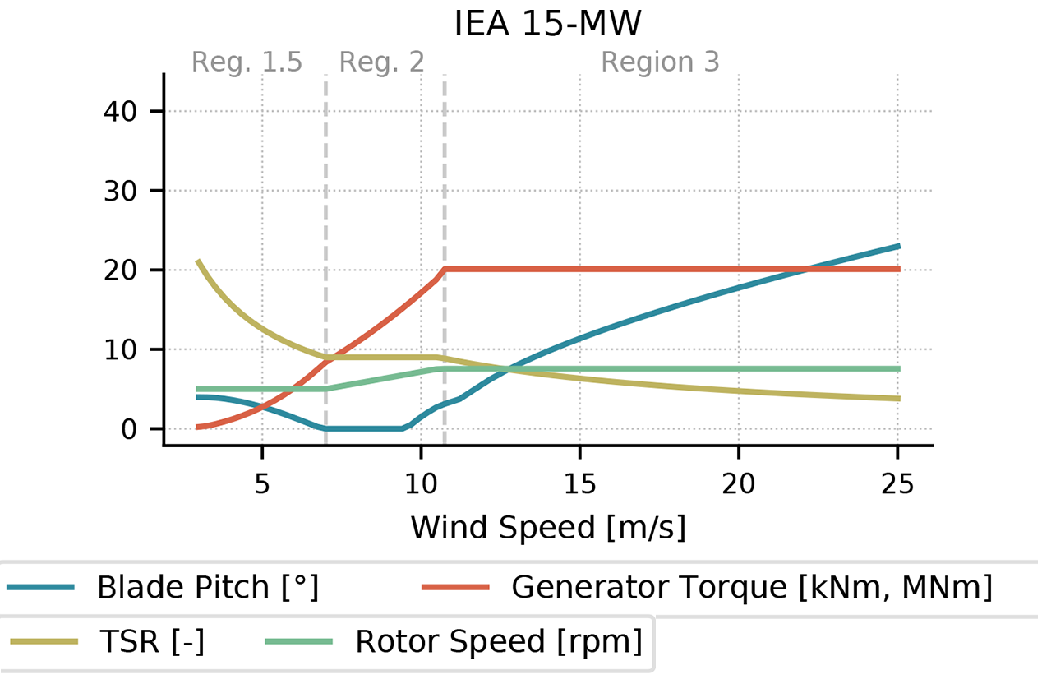
Control Module: CPC
Regime 2: Modulate generator torque
Regime 3: Modulate collective blade pitch angle

Slide 9
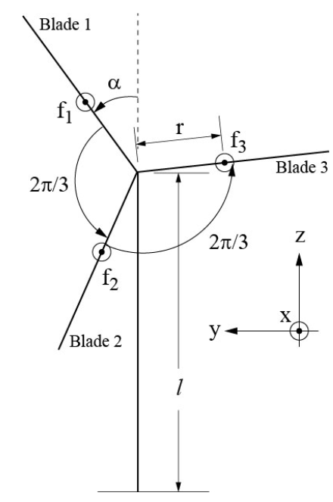
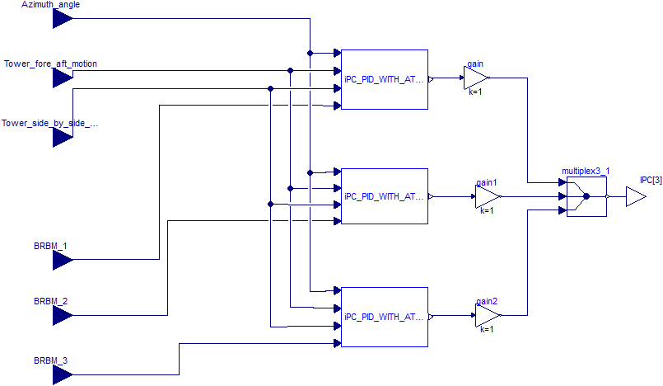
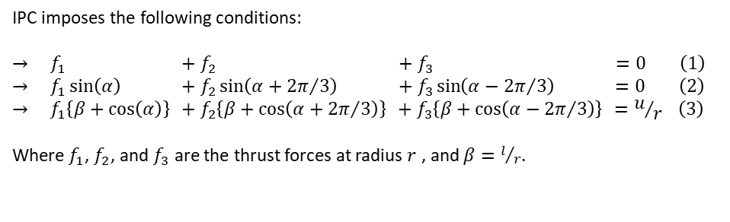
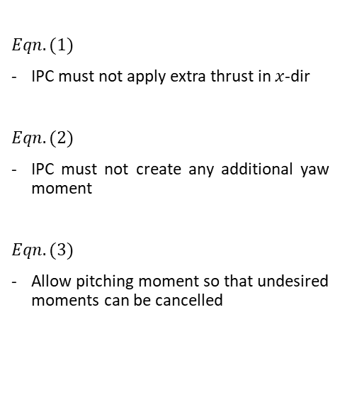
Control Module: IPC
The IPC controller uses the existing CPC as a baseline and provides individual blade pitch corrections for load reduction in BRBM, TSS, and TFA.
$Eqn. (1)$
IPC must not apply extra thrust in $x$-dir
$Eqn. (2)$
IPC must not create any additional yaw moment
$Eqn. (3)$
Allow pitching moment so that undesired moments can be cancelled
IPC imposes the following conditions:
$$→ f_{1} .+ f_{2} .+ f_{3} .=0 \left(1\right)$$
$$→ f_{1}\sin\left(α\right) .+ f_{2}\sin\left(α+{2π}/3\right) .+ f_{3}\sin\left(α−{2π}/3\right) .=0 \left(2\right)$$
$$→ f_{1}\left\{β+\cos\left(α\right)\right\} .+ f_{2}\left\{β+\cos\left(α+{2π}/3\right)\right\} .+ f_{3}\left\{β+\cos\left(α−{2π}/3\right)\right\} .=u/r \left(3\right)$$
Where $f_{1}$, $f_{2}$, and $f_{3}$ are the thrust forces at radius $r$ , and $β=l/r$.

Slide 10

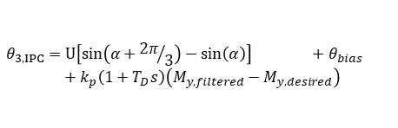
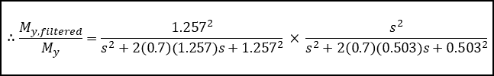

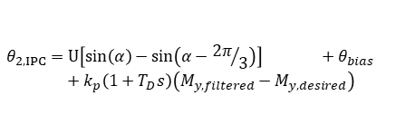

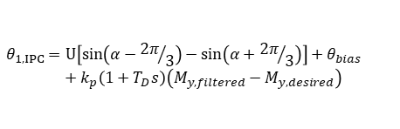


Control Module: IPC
General structure of IPC is:
The filters $G_{tt,1}\left(s\right)$ and $G_{tt,2}\left(s\right)$ convert displacement signals into velocity signals, allowing the use of velocity as a feedback to introduce damping.
Thus,
To capture the BRBM signal, a band-pass filter is used in the form of
with,
$$G_{tt, 1}\left(s\right)=G_{tt, 2}\left(s\right)=s\frac{ω^{2}}{s^{2}+\left(2ζω\right)s+ω^{2}}$$
with
$ζ=0.5$ , $f=0.7Hz$ $⟺$ $ω=2πf=4.4 rad/s$
$$θ_{1, IPC}=U\left[\sin\left(α−{2π}/3\right)−\sin\left(α+{2π}/3\right)\right]+θ_{bias}$$
$$+ k_{p}\left(1+T_{D}s\right)\left(M_{y, filtered}−M_{y, desired}\right)$$
$$∴G_{tt, 1}\left(s\right)=G_{tt, 2}\left(s\right)=s\frac{{4.4}^{2}}{s^{2}+4.4s+{4.4}^{2}}$$
$$θ_{2, IPC}=U\left[\sin\left(α\right)−\sin\left(α−{2π}/3\right)\right] +θ_{bias}$$
$$+ k_{p}\left(1+T_{D}s\right)\left(M_{y, filtered}−M_{y, desired}\right)$$
$$θ_{3, IPC}=U\left[\sin\left(α+{2π}/3\right)−\sin\left(α\right)\right] +θ_{bias}$$
$$+ k_{p}\left(1+T_{D}s\right)\left(M_{y, filtered}−M_{y, desired}\right)$$
$$\frac{M_{y, filtered}}{M_{y}}=\frac{{ω_{LP}}^{2}}{s^{2}+\left(2ζω_{LP}\right)s+ω_{LP}^{2}} ×\frac{s^{2}}{s^{2}+\left(2ζω_{HP}\right)s+ω_{HP}^{2}}$$
$$U=−ε_{tt,fa}G_{tt1}\left(s\right)k_{tt1}−ε_{tt,ss}G_{tt2}\left(s\right)k_{tt2}$$
$ζ=0.7$ , $f_{LP}=0.20Hz$ $⟺$ $ω_{LP}= 2πf_{LP} = 1.257 rad/s$
$ζ=0.7$ , $f_{HP}=0.08Hz ⟺$ $ω_{HP}=2πf_{HP} =0.503 rad/s$
$$∴\frac{M_{y, filtered}}{M_{y}}=\frac{{1.257}^{2}}{s^{2}+2\left(0.7\right)(1.257)s+{1.257}^{2}} × \frac{s^{2}}{s^{2}+2\left(0.7\right)(0.503)s+{0.503}^{2}}$$

Slide 11
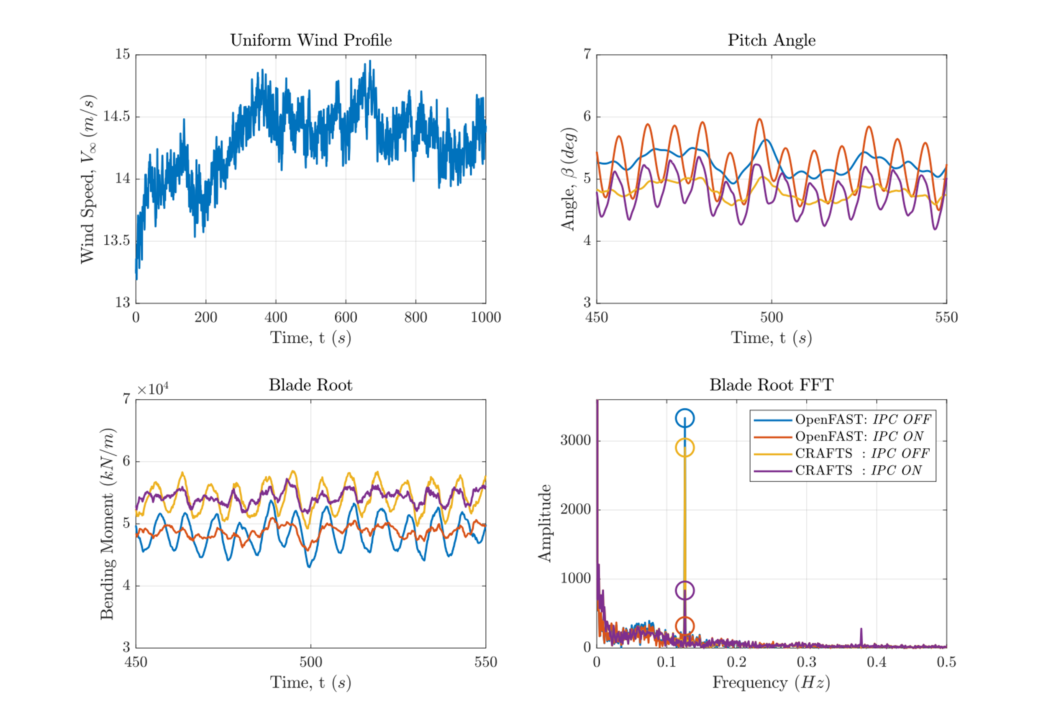
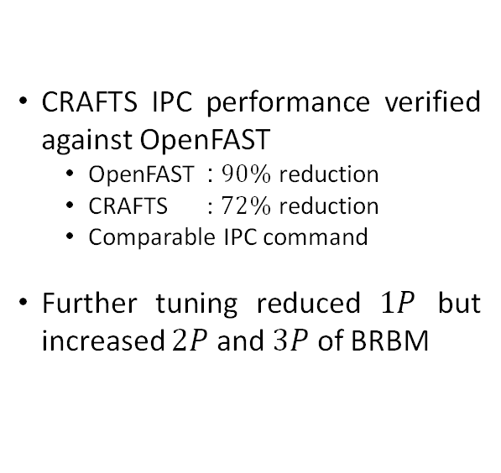
Results: CRAFTS vs. OpenFAST
CRAFTS IPC performance verified against OpenFAST
  OpenFAST : $90\%$reduction
  CRAFTS : $72\%$reduction
  Comparable IPC command
Further tuning reduced $1P$ but increased $2P$ and $3P$ of BRBM
Fig. 1: IPC Performance CRAFTS vs. OpenFAST

Slide 12
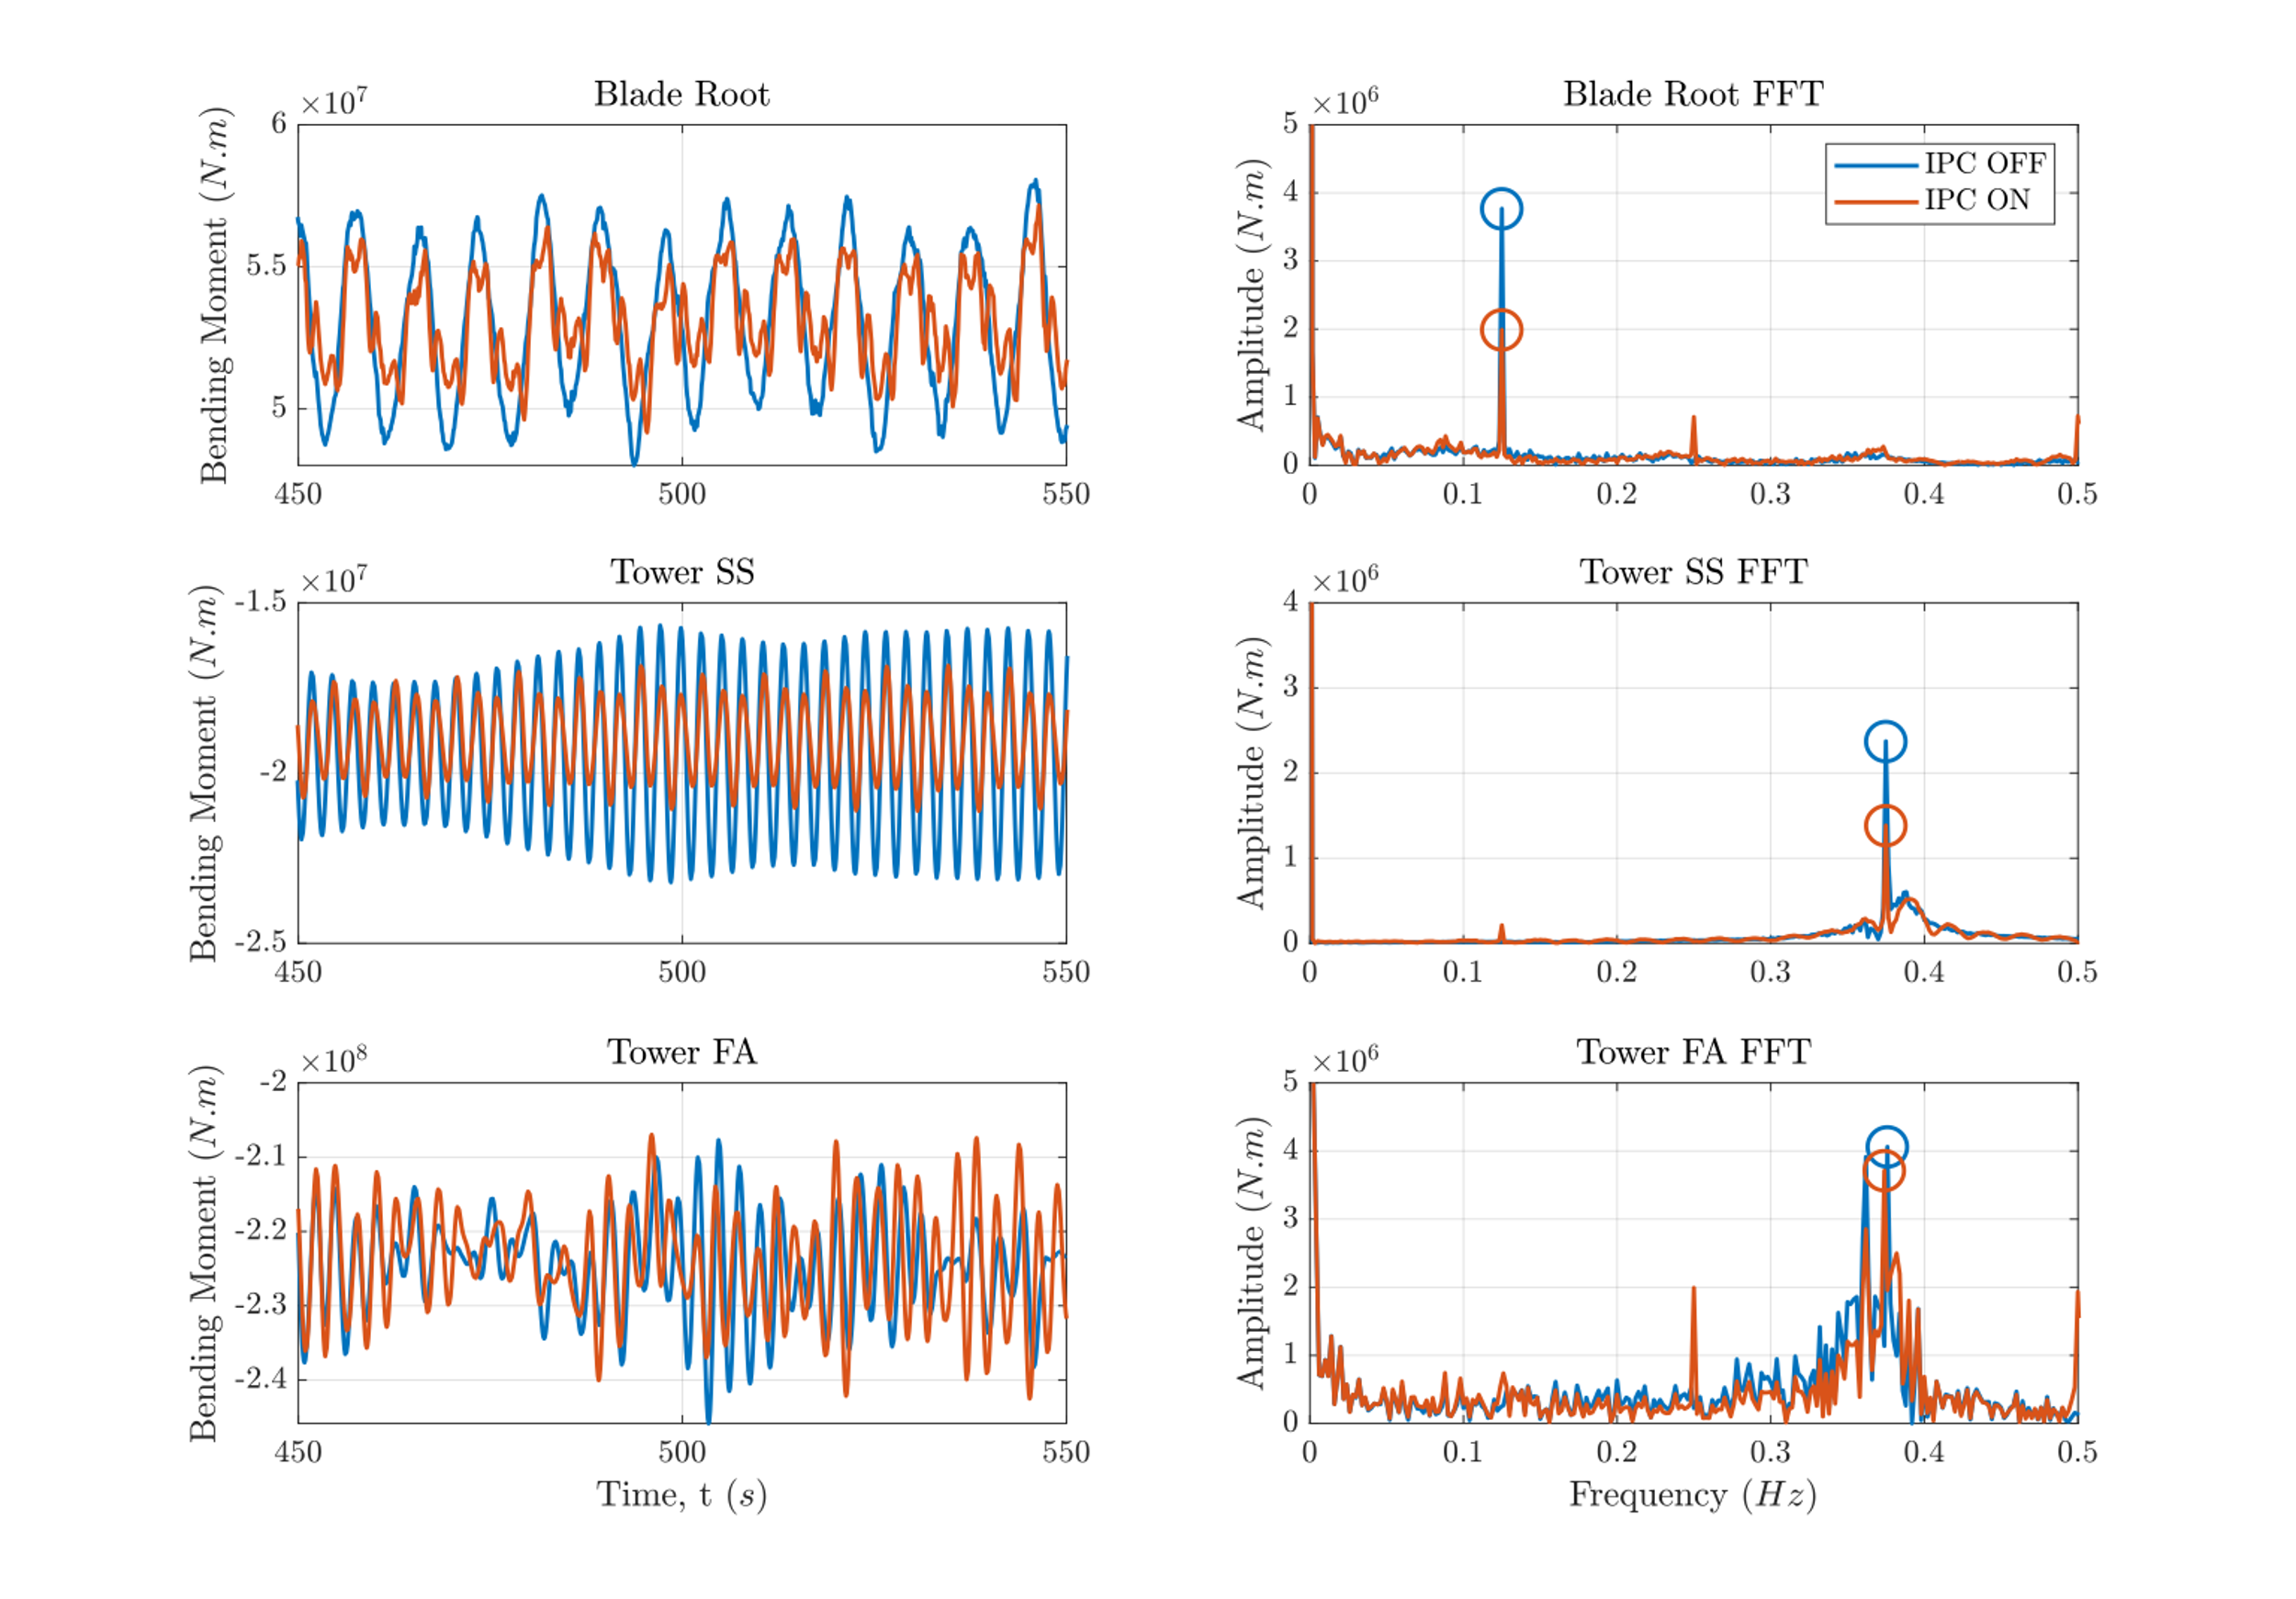
Results: CRAFTS
IPC has no detrimental effects on rotor speed and power generation
Fatigue load reductions in the blade root, TwrSS, and TwrFA bending moments.
Fig. 2: Fatigue load reduction by CRAFTS IPC

Slide 13
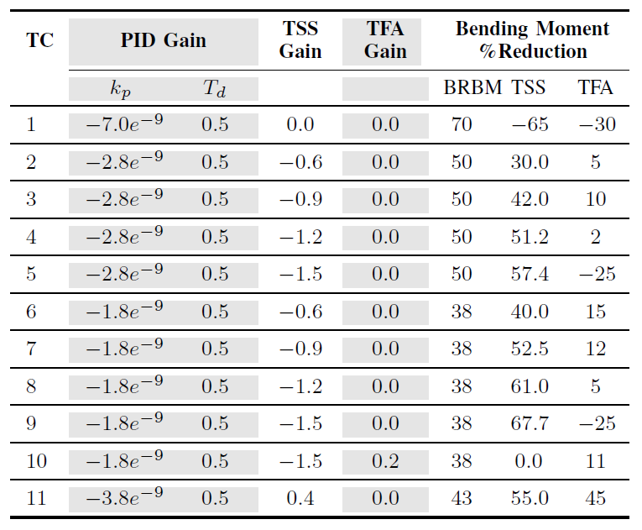
Results: Trade-Off Study
Table 1: Trade-off study of fatigue load reduction
Trade-off study carried on to determine effect of a multitude of gains
  Large BRBM reduction increase TwrSS
  Reduction of TwrSS has NO effect on BRBM
  TwrFA is coupled to BRBM and TwrSS

Slide 14



Project funded by the U.S. Department of Energy Advanced Research Projects Agency for Energy (ARPA-E) under grant DE-AR0001187
Notes:
I’m

